Slide 1
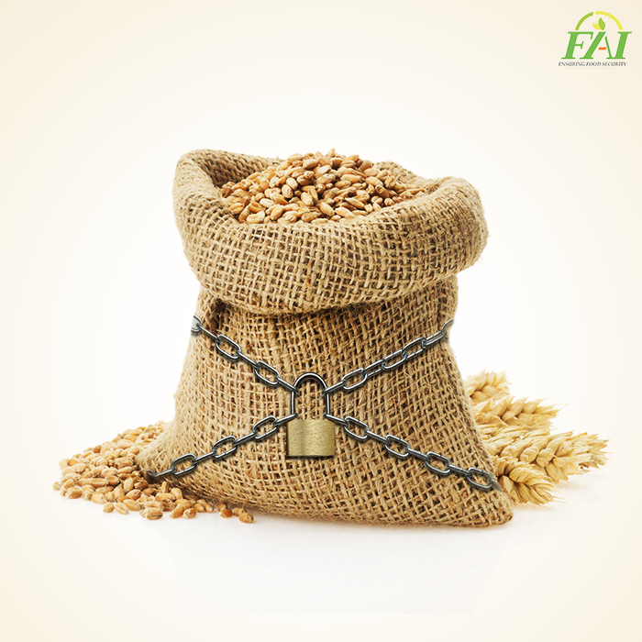
About fertilisers
Understanding about importance of fertiliser in agriculture is vital
Post
Fertilisers help meet the need of food, fiber, fuel and feed for our growing population. Deficiency of plant nutrients in soil is on rise. To replenish the same for ensuring food security, use of fertiliser is indispensable.

Slide 2
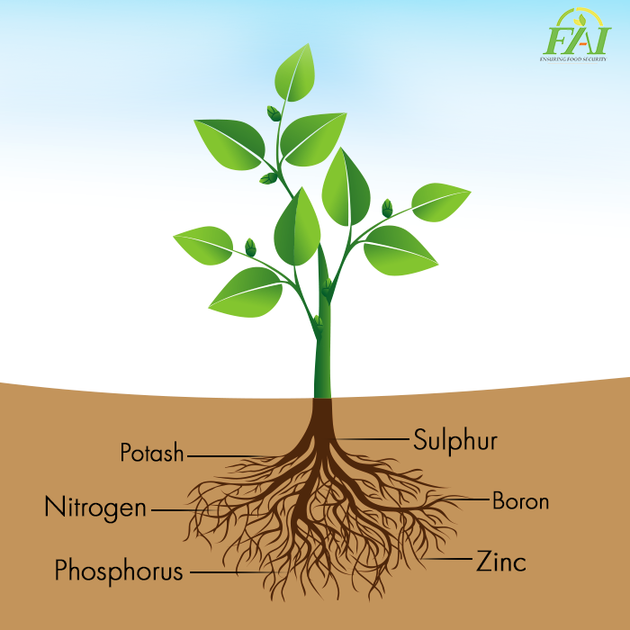
Benefits of fertilisers
This will describe the various benefits / advantages of fertilisers
Post
Fertilisers contain essential nutrients in specific ionic forms which plant roots are capable of absorbing and help in better food production.

Slide 3
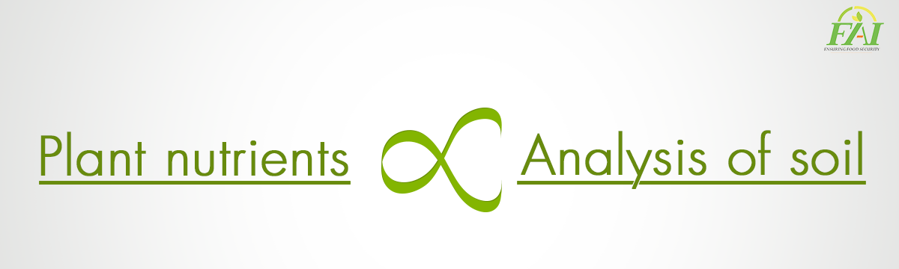
Benefits of fertilisers
This will describe the various benefits / advantages of fertilisers
Post
Plant nutrients need to be applied in balanced proportion on analysis of soil. Balanced fertilisation improves soil health.

Slide 4
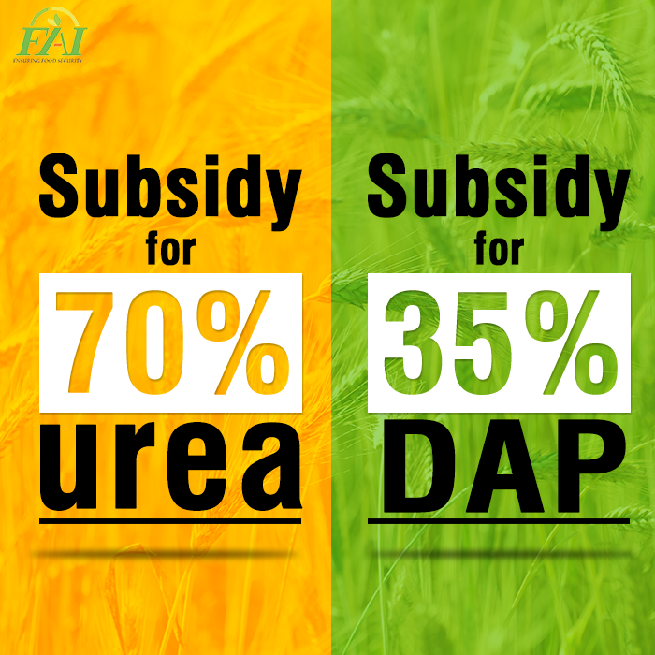
Why imbalanced fertilisation
The facts and figures about the Government subsidy leading to imbalanced use of fertilisers and suggestion to address the issue.
Post
Government provides subsidy of more than 70% of cost of urea. DAP is subsidised only by 35% of the cost. This has led to low cost of urea and high cost of DAP to the farmer tempting him to use more urea at the cost of DAP. Result is imbalanced use of fertilisers.

Slide 5
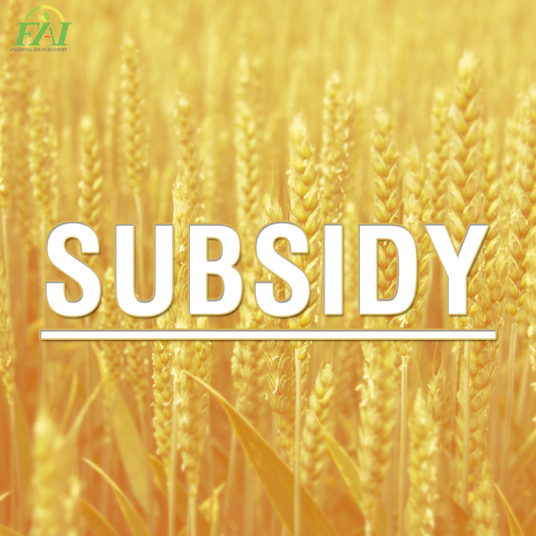
Why imbalanced fertilisation
The facts and figures about the Government subsidy leading to imbalanced use of fertilisers and suggestion to address the issue.
Post
Subsidy on different products should be fixed in a manner that the corrosponding retail prices encourage farmers to use fertilisers in balanced proportion.

Slide 6
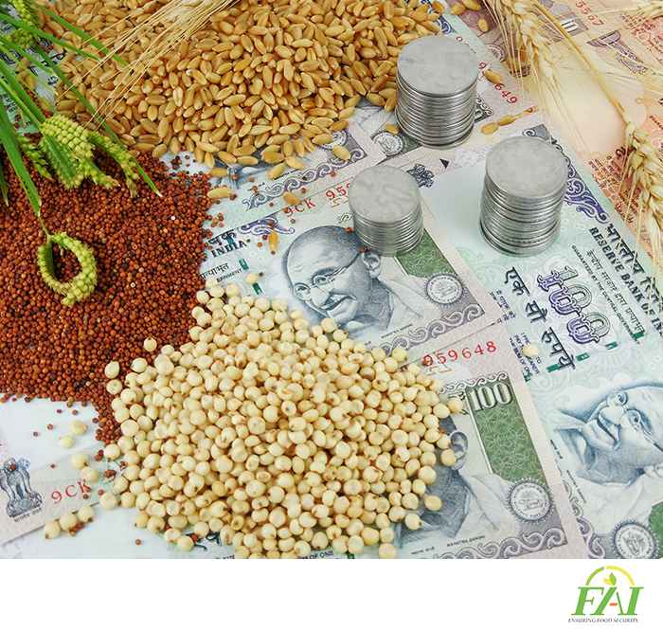
Some facts about fertiliser subsidy
This will describe about the facts on inordinate delay in payment of subsidy, cash flow problems and losses incured by this vital sector
Post
Government make inadequate provision of funds in annual budget. Payment of legitimate dues of the industry is inordinately delayed. There is always cash flow problems . Industry borrows money at high rate of interest. Many urea units are incurring losses and others may follow soon.

Slide 7
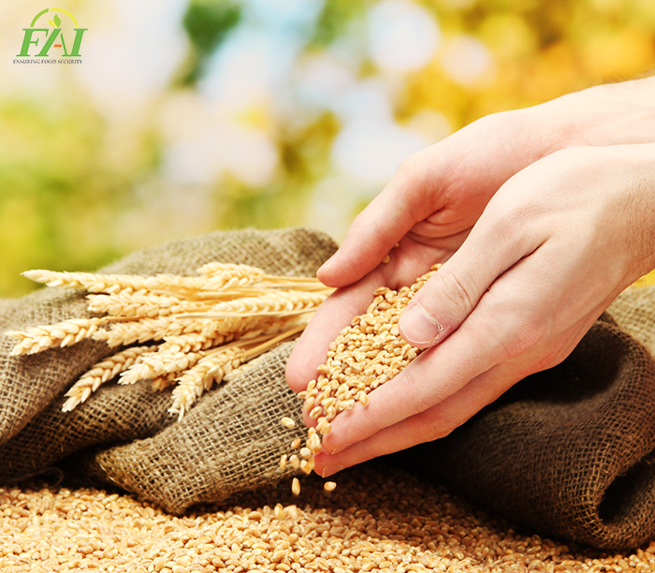
Some facts about fertiliser subsidy
This will describe about the facts on inordinate delay in payment of subsidy, cash flow problems and losses incured by this vital sector
Post
Industry is moving towards sickness. Corrective measures to save this industry are urgently required. Adequate allocation of funds and timely payment of subsidy will help in ensuring viable operation of industry.

